Slide 1
The Social pandemic- Violence against women
File created on: 11/5/2022 10:15:50 AM

Slide 2
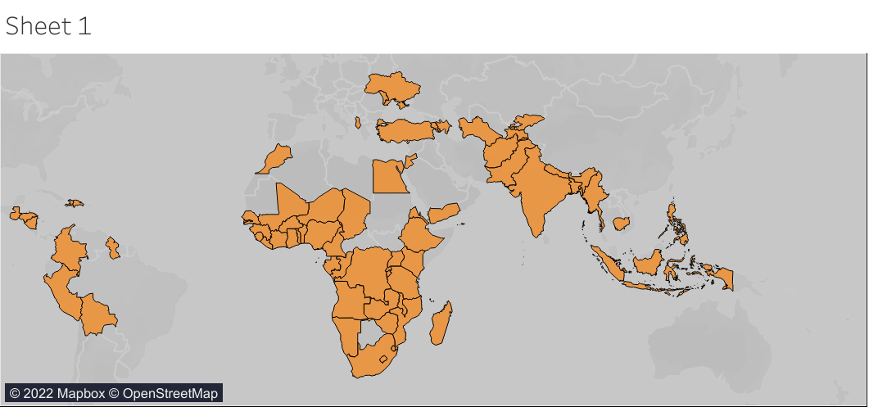

Slide 3
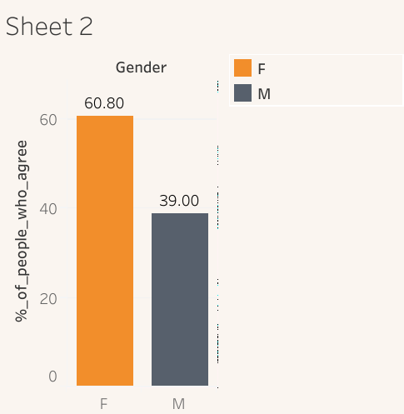

Slide 5
